Slide 1
HTML Images
COMP 2511 - Web I: Client Development
Randy Connolly
Modified by Yasaman Amannejad & PJ Perri
Department of Mathematics and Computing,
Mount Royal University

Slide 2
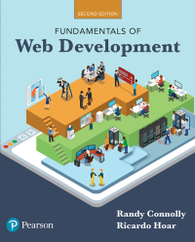
Objectives
Textbook: Fundamentals of Web Development
Chapters 3
By the end of this part of the course, you will
learn how to work with images in HTML

Slide 3
Images
The most popular image formats used by web developers today are PNG (Portable Network Graphics) and JPEG (Joint Photographic Experts Group).
BTW: jpg, JPG, JPEG, jpeg, jpe → all the same
Can also use Gif and Svg, the latter is an object oriented format.
Users can create images using specialized software, such as Adobe Photoshop Express (www.photoshop.com), G.I.M.P. (www.gimp.org), Inkscape (www.inkscape.org) and many more.

Slide 4

IMPORTANT NOTIFICATION
All images, published on the internet, are considered copyright.
Use of copyright material is illegal, unethical, and academically dishonest.
Use of uncited images is plagiarism.
So?
Always cite.
Use images from sources that use Creative commons copyright licenses.
Google will search for them for you.

Slide 5
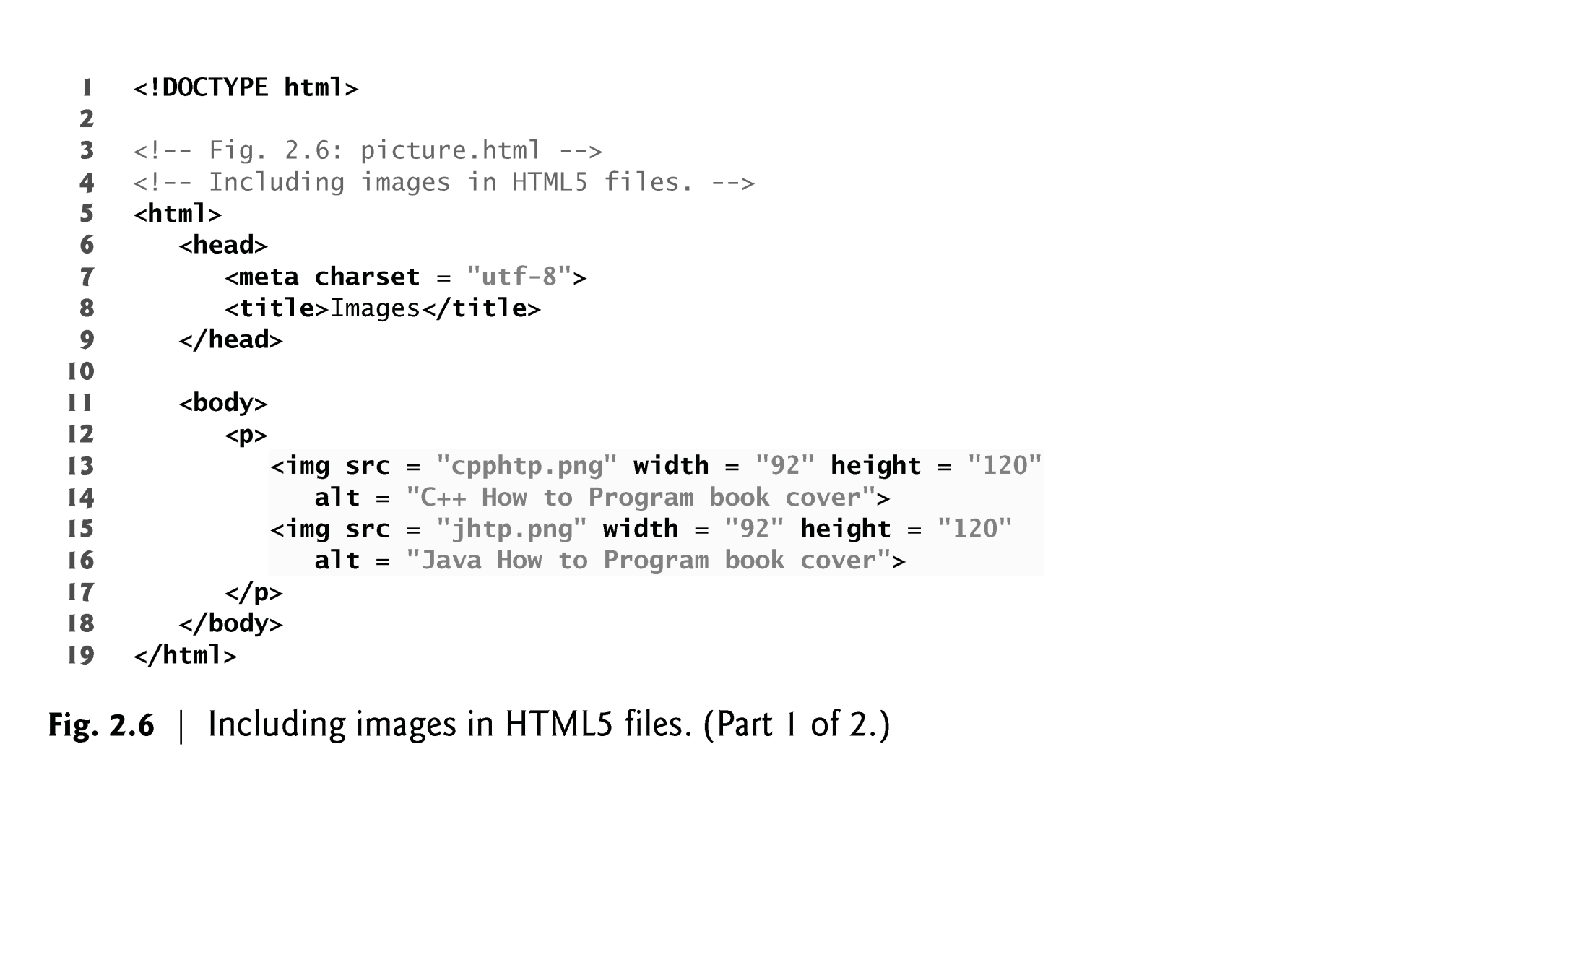
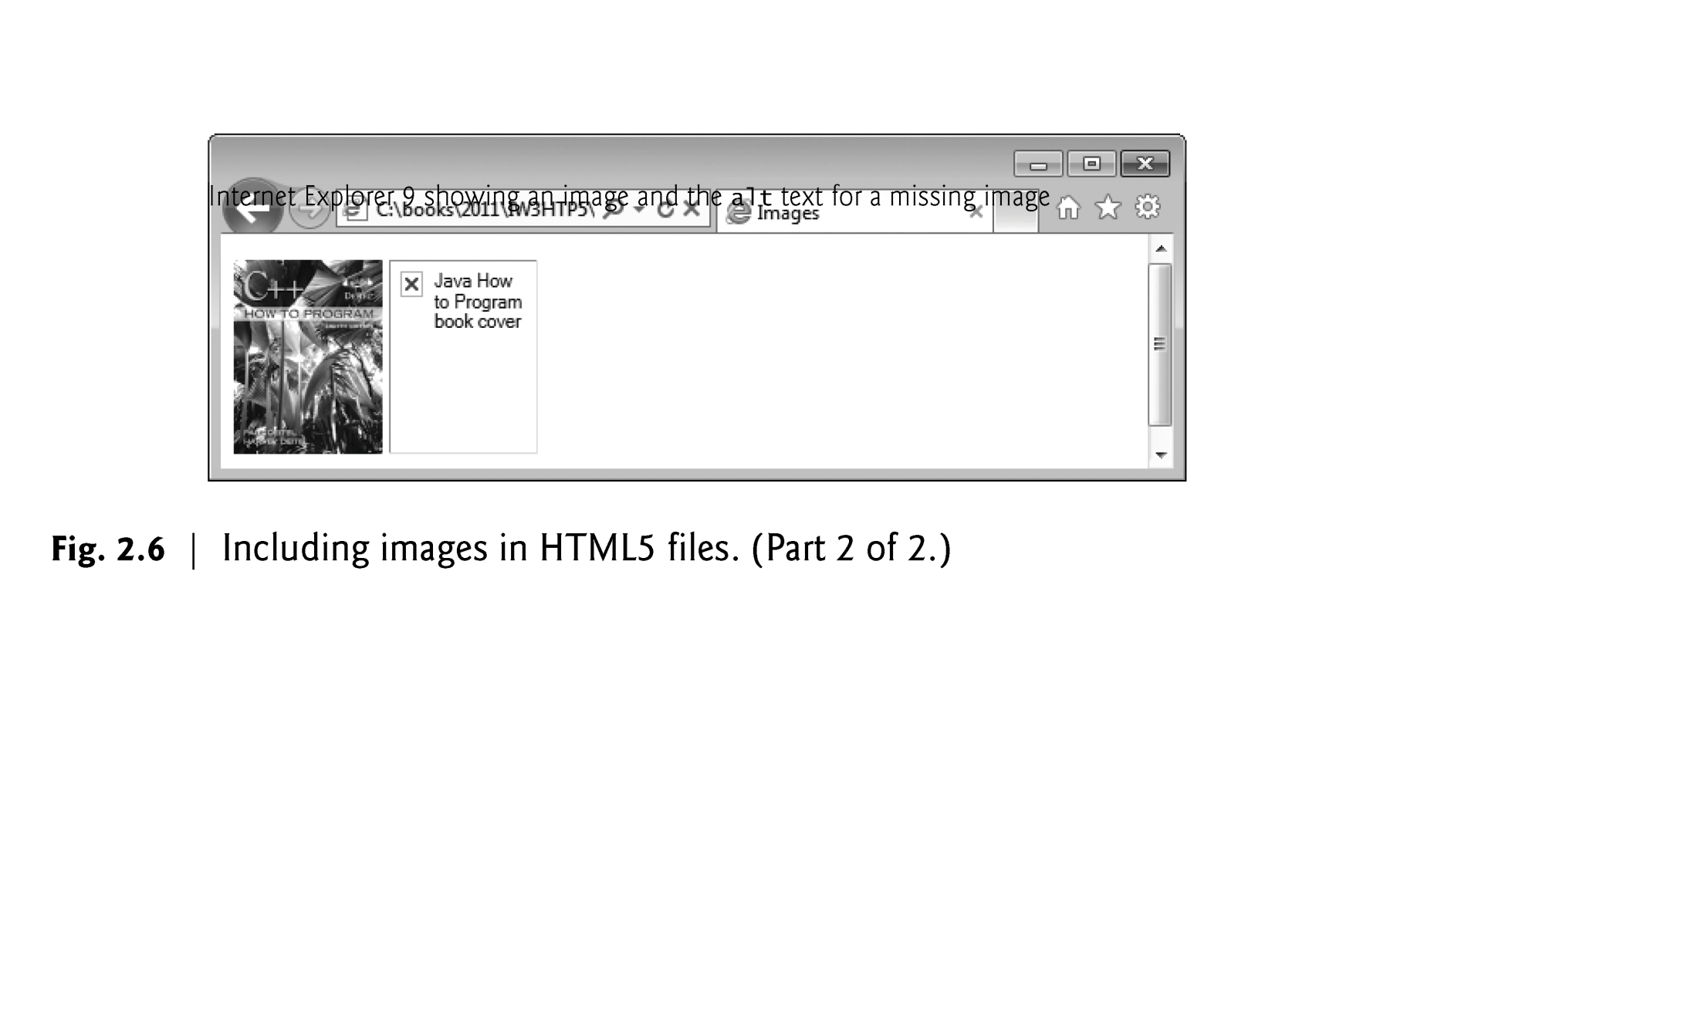

Slide 6
Image tag Syntax

Slide 7
Images
The img element’s src attribute specifies an image’s location
Every img element must have an alt attribute.
A browser may not be able to render an image.
If a browser cannot render an image, the browser displays the alt attribute’s value.
The alt attribute is also important for accessibility—speech synthesizer software can speak the alt attribute’s value so that a visually impaired user can understand what the browser is displaying.
For these reasons, always include an alt attribute that describes the image’s contents.

Slide 8
Image attributes: width & height
Width and height are optional attributes
If omitted, the browser uses the image’s actual width and height
Images are measured in pixels and dimensions are enclosed in quotes
Always include the width and height of an image in the <img> tag
When the browser loads the HTML file, it will know how much screen space to provide and can lay out the page properly. Pages load and rendered faster.
Entering new dimensions for an image that change its width-to-height ratio distorts the appearance of the image. To avoid distortion, keep the same width-to-height ratio. In other words enter either width or height but not both.
Similarly, never flip an image.

Slide 9
Images encode with Void element tag
Some HTML5 elements (called void elements) contain only attributes and do not mark up text (i.e., text is not placed between a start and an end tag).
You can terminate void elements (such as the img element) by using the forward slash character (/) inside the closing right angle bracket (>) of the start tag. Note: Do not do this in JTML 5!
For example:
<img src = "jhtp.png" width = "92" height = "120"
alt = "Java How to Program book cover" />

Slide 10
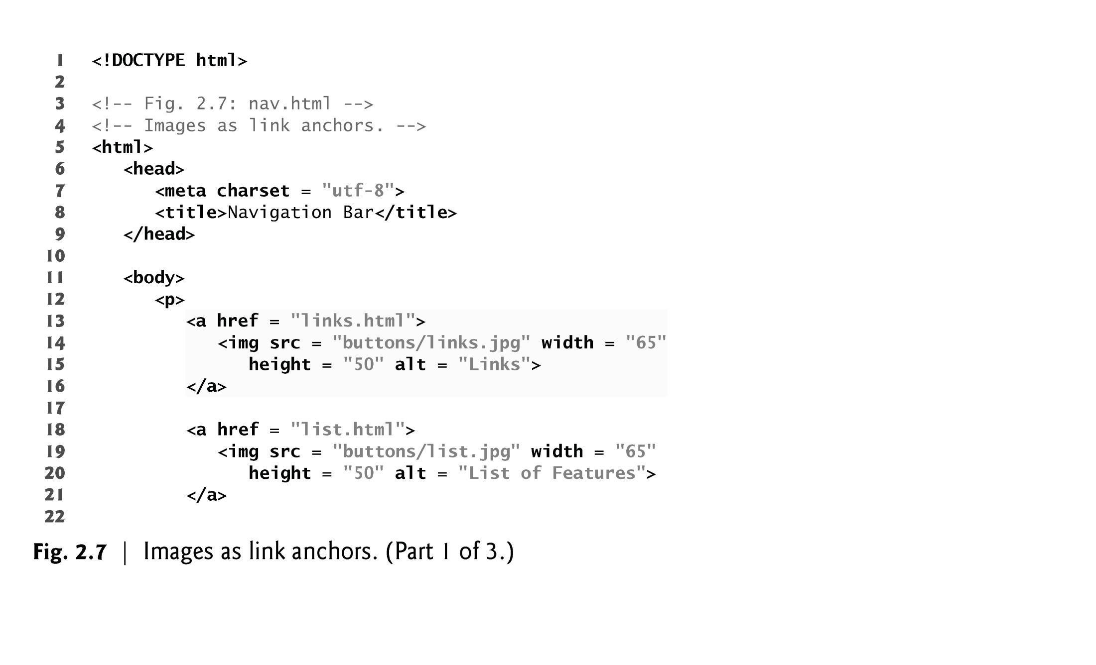
Images as Hyperlinks
By using images as hyperlinks, you can create graphical web pages that link to other resources.
Clicking an image in this example takes the user to a corresponding web page—one of the other examples in this chapter.

Slide 11
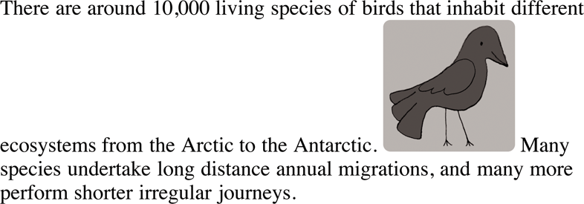
Where to Place Images in Your Code
<p>There are around 10,000 living species of birds that inhabit different
<img src="images/bird.gif" alt="bird" width="100" height="100" />
ecosystems from the Arctic to the Antarctic. Man species undertake long distance annual migrations, and many more perform shorter irregular journeys.
</p>

Slide 12
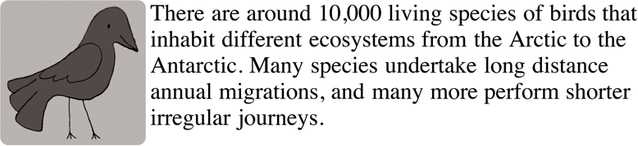
Aligning Images Horizontally
<p>
<img src="images/bird.gif" alt="bird" width="100" height="100" align="left" /> There are around 10,000 living species of birds that inhabit different ecosystems from the Arctic to the Antarctic. Man species undertake long distance annual migrations, and many more perform shorter irregular journeys.</p>
Note : We should use CSS for image alignment.

Slide 13
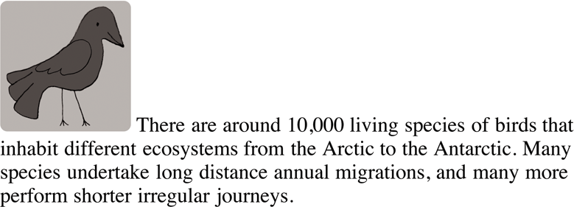
Aligning Images Vertically
<p><img src="images/bird.gif" alt="bird" width="100" height="100" align="top" /> There are around 10,000 living species of birds that inhabit different ecosystems from the Arctic to the Antarctic. Man species undertake long distance annual migrations, and many more perform shorter irregular journeys.</p>
Note : We should use CSS for image alignment.

Slide 14
Figures and Captions
The figure element describes a figure (such as an image, chart or table) in the document so that it could be moved to the side of the page or to another page.
The figcaption element provides a caption for the image in the figure element.

Slide 15
Putting it Together
html for logo with caption below and citation for source.
<figure>
<img src=“images/logo.png” alt=“Logo” width=“150” height=“100”>
<figcaption>“Organization Logo” </figcaption>
<cite>https://www..myorg.com/images/logo.png”</cite>
</figure>

Slide 16
Any Question?

